Slide 1
Data Analysis
Introduction

Slide 2
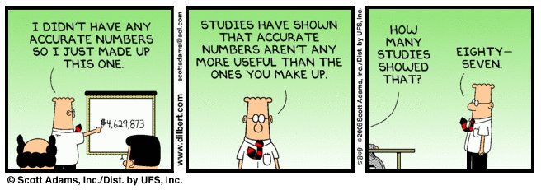
Data Analysis

Slide 3
More or Less Review
Key points of the review
Data quality
Correlation
Impact of confidence level

Slide 4
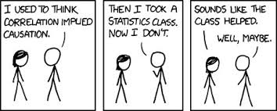
Review

Slide 5
Data Summary
Averages
Mean and median
Spread
Standard deviation, interquartile range

Slide 6
Problem solving
How does heat seal temperature effect seal strenght ?
Controls
Variables
Data points
Analysis

Slide 7
Research Questions
How are these variables related?
Is data set 1 different from data set 2?
Is this data distribution as expected?
How confident am I?

Slide 8
Question
How does the price of potatoes affect the amount of potatoes sold?

Slide 9
Dependent and independent variables
Independent variable
Horizontal axis
Dependent Variables
Vertical axis
Scatter Graph

Slide 10
Relationship

Slide 11
Linear relationships
Y = mX + c
Y dependent variable
X independent variable
m gradient (Slope)
C intercept on Y axis (X = 0)

Slide 12
Relationship

Slide 13
How well does the data fit?
Is the data close to the line of best fit?
Are other lines of best fit possible?
Correlation coefficient
= 1 perfect positive correlation
= -1 perfect negative correlation
= 0 no correlation

Slide 14
Relationship

Slide 15
Correlation Coefficient
Pearson's product moment correlation coefficient.
How far does the data deviate from the line of best fit?
When it is significant?

Slide 16
Relationship

Slide 17
Relationship

Slide 18
Interpolation
We can estimate values for the function between points which we have measured.
Care required encase of step changes
The larger the gaps in the data the greater the risk

Slide 19
Extrapolation
We can estimate the values of a function outside the range of which we have measured
Greater risks of error the larger the estimated value is from the measured values
Check against expected behaviour

Slide 20
Are sets A and B different?
For interval or ratio data
Are the mean values different
Is the difference unlikely to have come about from random variability
How confident do we want to be?
Conduct t test

Slide 21

Testing for differences
Test for difference
Cannot test for sameness!!!
Find difference
Fail to find difference

Slide 22
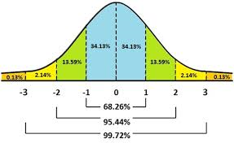
Normal Curve & Standard Deviation

Slide 23
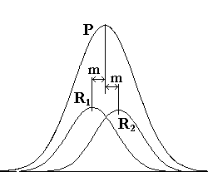
Determination of Confidence in the mean
Sample size n
R 1 sample set 1
R 2 Sample set 2
P Distribution of all possible samples of size n
How confident do you want to be?

Slide 24

Noddy’s Guide to Hypotheses Testing
Null Hypotheses H₀
Often no effect, e.g. A and B are the same
Alternative Hypotheses H_{a}
Often the effect we are interested in, A and B are not the same
Test the H₀
Confidence in rejection of the H₀
95% ?
Accept H_{a}

Slide 25

Errors
Type I
Reject H₀ when true
Significance level
Type II
Fails to reject H₀ when false
False negative
Just wrong

Slide 26
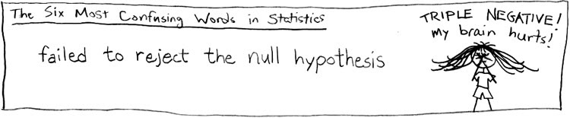
Outcome
Reject Null hypothesis
Fail to reject the null hypothesis
Fail to reject is not the same as accept

Slide 27
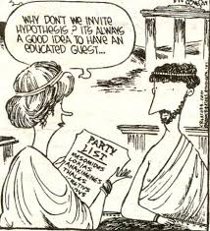
Hypothesis Testing
Educated Guess
Probablistic

Slide 28
Are A & B Different
Treatment 1 and Treatment 2
Ingredient X and ingredient Y
Group A and B
Interval or ratio data
Difference in mean values
Ho – No difference in A & B
Ha – There is a difference in A & B
Use T test

Slide 29
T- Test
In Excel t test
2 arrays of data
1 or 2 tail
Generally use 2 tail
Type
Generally use type 3 (Up-paired unequal variance)
If P < 0.05
reject the Ho at 95% confidence level
If P > 0.05
Failed to reject the Ho at 95% confidence level.

Slide 30
Results
T test indicated that A and B are different at a 90% confidence level (p=0.08)
T test failed to indicated that A and B are different at 90% confidence level (P=0.12)

Slide 31
Are the frequencies expected?
X f
1 5
2 4
3 8
4 6
5 4
6 9
Frequencies in test groups
Determine expected values
Theoretically
Empirically
Ho Actual and expected are similar

Slide 32
Are the frequencies expected?
X f e
1 5 6
2 4 6
3 8 6
4 6 6
5 4 6
6 9 6
Chi Test in excel
Expected f >5
If P < 0.05
reject the Ho at 95% confidence level
If P > 0.05
Failed to reject the Ho at 95% confidence level.

Slide 33
Results
Chi test indicated that A and B are different at a 90% confidence level (p=0.08)
Chi test failed to indicated that A and B are different at 90% confidence level (P=0.12)

Slide 34
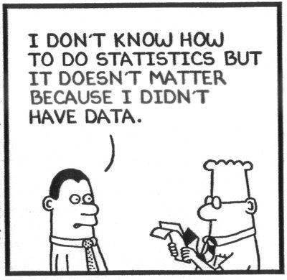
Statistics in Marketing

